Slide 1
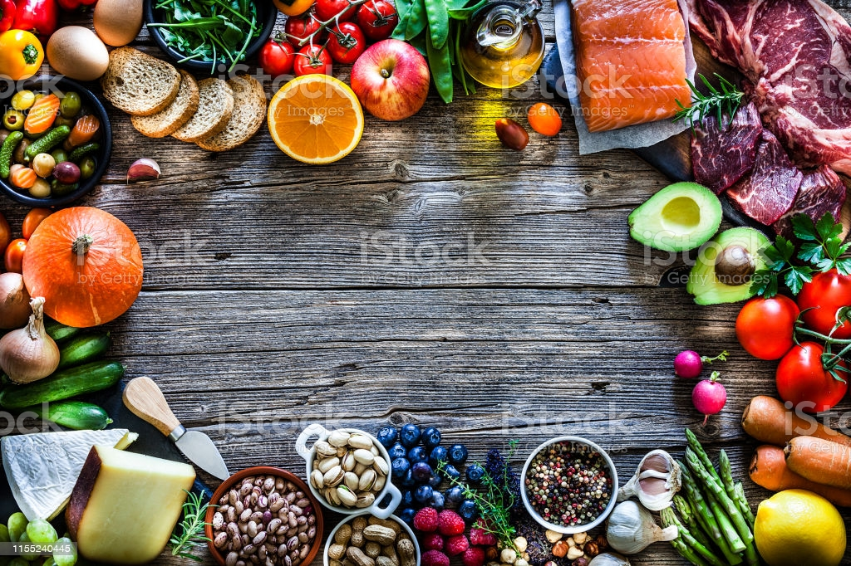
^{COVID-19}
CONSUMERS FOOD CONSUMPTION SURVEY & BEHAVIOR ANALYSIS

Slide 2

Agenda
Introduction
Problem Statement
Survey Objectives
Research Design/Methodology/Approach
Sample & data Collection
Key Findings
Solution Description
Solution & Impactful Results

Slide 3
Introduction
After the novel coronavirus disease 2019 (COVID-19) was declared a pandemic by the World Health Organization in March 2020, its devastating effects began to be closely monitored all over the world.
The new order that emerged due to the fight against the virus soon began to affect all our habits and behaviors. The fact that food consumption is vital for human well-being makes this an important area to investigate in terms of the impact of COVID-19.
This research/Survey was carried out to investigate the changes in consumers' food consumption behavior and habits during the COVID-19 pandemic.

Slide 4
Problem Statement
Understanding the Food consumption behavior pattern , choices of food & diet which are suggested by the respondent during the covid -19 which will be helpful to know about the - behavior trend based on different demographic criteria & create the healthy diet chart for the future through the analysis of the respondent experiences.
Identifying the Behavior pattern of food consumption during the covid-19
Analyze the healthy diet plan by comparing the different choices of food

Slide 5
Objective
To ascertain the impact of the demographic variables in consumer’s food preferences during the pandemic situation .
To analysis of Behavior pattern of food Preferences during the covid-19
Analyze the healthy diet plan by comparing the different choices of food & time preferences.
Preference Analysis for vitamins & minerals .
To ascertain the changes of food preferences during infected by the covid-19.

Slide 6
Survey Design/Methodology/Approach
Present study is based on Descriptive research strategy , data was collected from the respondents in India from the different regions with the help of structured Google questionnaire.
Data gathered through the survey was analysed and interpreted with the help of Microsoft Excel and tested by the excel tool(Pivot tool) /Formulas.

Slide 7
Sample & data Collection
For present study , the structured Google questionnaire was to be carried out to elicit the required information from the customers of different areas in India.
Quantitative data was collected from a self-administered Google questionnaire.
Information was also gathered about Demographic factors , preferences & food consumption behaviour of the consumer.
In the present study ,Convenience sampling technique has been applied based on the parameters of interest, an optimum sample size of 150 respondents was selected to full-fill the sample requirements of representation, flexibility and reliability.
Out of 150 ,105 response received , which were found suitable to conduct the final analysis.
The survey was conducted during 13 July to 18 July ( 2021) .

Slide 8
Key Findings – Demographic variables distribution

Slide 9
Key Findings – Breakfast preferences

Slide 10
Key Findings –Lunch preferences

Slide 11
Key Findings – Covid-Infected People Preferences

Slide 12
Key Findings – Covid-Infected People Preferences

Slide 13
Key Findings – Preferred Meal

Slide 14
Key Findings – Veggies Buying Pattern

Slide 15
Key Findings – Ayurveda product preferences

Slide 16
Key Findings – Demographic distribution of water & food consumption frequency

Slide 17
Key Findings – Fruits Preferences

Slide 18
Key Findings- Food Preferences

Slide 19
Solution Description
Analysis of food (in Breakfast/Lunch) consumption pattern analysis based on different demographic variables.
Identifying the Covid infected people Food & Fruits Preferences for vitamin & minerals.
Understanding the daily frequency of food & water consumption based on different criteria.
Identifying the region/age wise ayurvedic products preferences.
Analyze the Veggies buying pattern analysis during the Covid-19.
Comparing the variables to analyze the health diet plan & daily preferences which are preferred by the different groups of respondents.

Slide 20
Solution & Impactful Results
By this Survey We have collected 105 response & As per the analysis of the responses which are based on different food ,Veggies, Fruits & daily consumption preferences with the different demographic variables , we identifies different food consumption pattern & changes in food preferences during the covid-19 –
Through the survey response, it is noticed that 82 response received from 18-30 age grp out of total 105 responses where are 68 male or 37 female. & highest responses received from North Zone that is 48% (50 responses).
& it is identified the food pattern there every age group & region have highest preferences in breakfast - Protein items /Fruits / Grains & in lunch - Dal/ Rice/ Chapatis & Veggies which are healthy food items& highly recommended by doctors in this pandemic situation for every people.

Slide 21
Solution & Impactful Results Continue….
Further we analyzed that 21 (20% out of total ) people had infected by covid-19 out of 105 people as per out response. Covid have been highly impacting to the 18-30 age group of people as per the analysis. So there is need to be give more attention or keep safety for the young age (18 to 30) of people a
Covid infected people had highly preferred fruits are apple , Kiwi , papaya & orange for the high frequency of vitamins & minerals.
Further we noticed that respondents highly preferred meal is veg meal during the covid but 18-30 age grp of people also preferring the both veg & nonveg in the pandemic for the protein.
It also noticed that as per the study they highly preferred to buy the fresh veggies in alternate day & daily .

Slide 22
Solution & Impactful Results Continue….
As per the study 70% people taking the Ayurveda products for safety from cold as a herb. & taking the 3 times food n a day & drink 4 to 3 liter water & highly preferred apple & kiwi & protein items on daily basis. This diet plan & consumption pattern is highly recommended asper the analysis & as per WHO instruction to avoid the decease & helping to create better immunity system.

Slide 23
Thank You

